Slide 1
Modeling the 2008 June 1 CME with an Evolving Flux Rope
The CME is off the east limb from STEREO-A’s perspective, but is a faint halo event as seen from STEREO-B.
This is clearly a front-side halo from B’s perspective despite the fact that there is little if any visible surface activity at all at the time of the CME (Robbrecht et al. 2009, ApJ, 701, 283).
This is a very slow CME, with speeds of only ~200 km/s in the COR2 FOV.
The CME is continuously observable in SECCHI images all the way out to 1 AU, where the CME hits STEREO-B on June 6 (Möstl et al. 2009, ApJL, in press)..
COR2-B
COR2-A

Slide 2
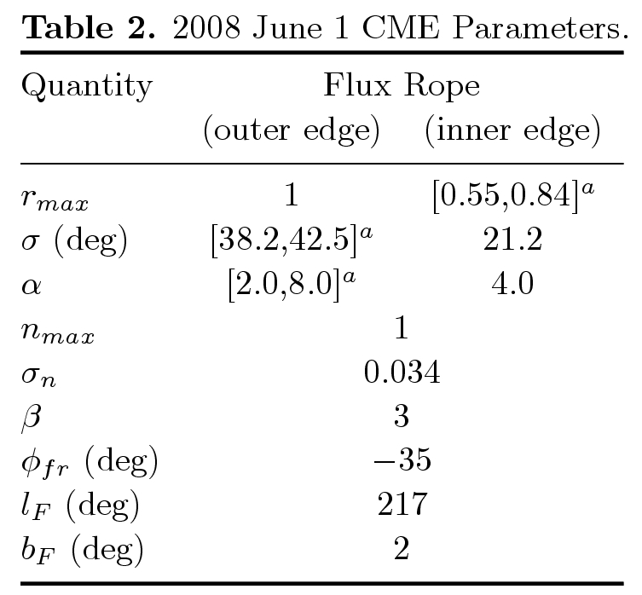
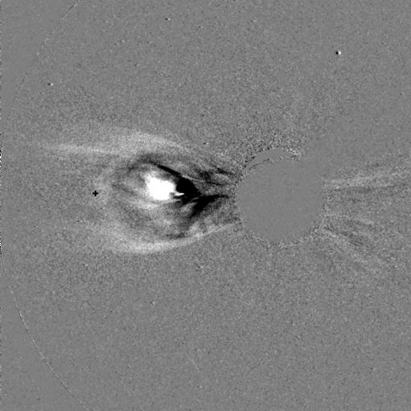
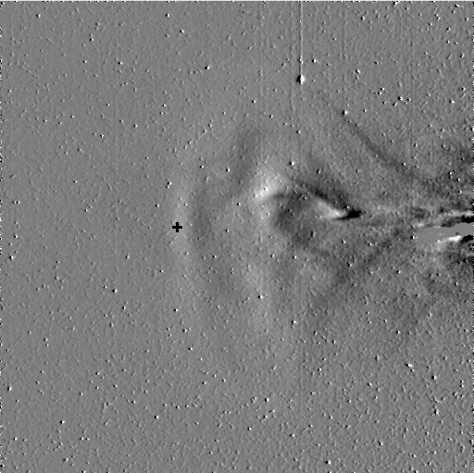
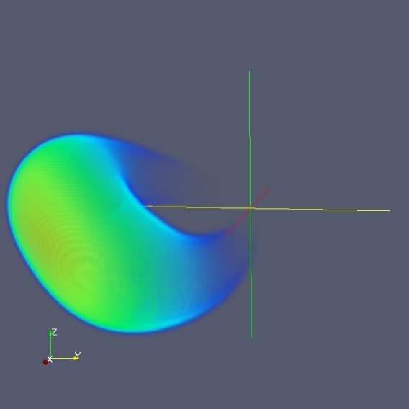
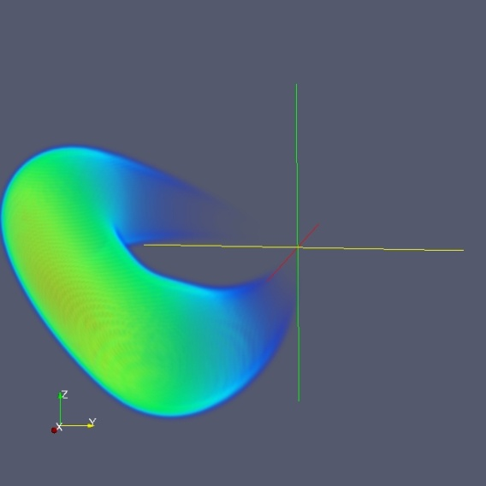
Creating a Parameterized Evolving Flux Rope CME
The flux rope is computed using the following equations:
Ranges [x_{min},x_{max}] are quoted above for the 3 quantities that are time-variable, where the quantity is then computable using
where t₀ and t_{r} are additional parameters for the analysis. Assuming t=0 corresponds to 11:45 UT on 2008 June 1, we settle on values of t₀=40 hr and
t_{r}=15 hr.

Slide 3
Comprehensive Movie of 2008 June 1 CME

