Slide 1
Relation between Type II Bursts and CMEs Inferred from STEREO Observations
Solar Physics – under review
N. Gopalswamy, W. Thompson, J. Davila, M. Kaiser NASA Goddard Space Flight Center, Greenbelt, MD S. Yashiro Interferometrics, Herndon, VA P. Mäkelä, G. Michalek The Catholic University of America, Washington, DC J.- L. Bougeret Paris Observatory, Meudon, France R. Howard Naval Research Laboratory, Washington, DC
STEREO SWG February 3-5, 2009 Pasadena

Slide 2
Motivation
CME leading edge at metric type II burst onset: the height of shock formation
LASCO: CME leading edge associated with ~130 limb type IIs 2.2 Ro [Gopalswamy et al., 2005, JGR] – extrapolation of height-time
~1.6 Ro for type II bursts in GLE events
Exploit COR1 capability: minimal or no extrapolation (FOV inner edge ~1.4 Ro)
LASCO/C2 misses the early evolution
Explain the universal drift-rate spectrum

Slide 3
Motivation: CME height at metric type II onset is generally extrapolated. SECCHI/COR1 can solve this problem
More type II bursts have spatial
overlap with CMEs
Gopalswamy et al. 2005
Notes:
One of the major advantages of SECCHI is the inner edge of the fov closer to the sun. More type II bursts have spatial overlap with CMEs

Slide 4
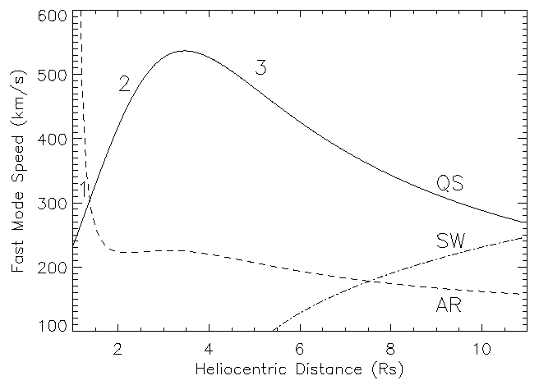
Onset of Shock, Type II, Particle Release
1.6 Ro
4.4 Ro
5.6 Ro
7 Ro
Type II
>40 MeV
GLE
>13 MeV
DH
Fast Mode Speed (km/s)
Heliocentric Distance (Rs)
Gopalswamy et al., 2001, 2008

Slide 5
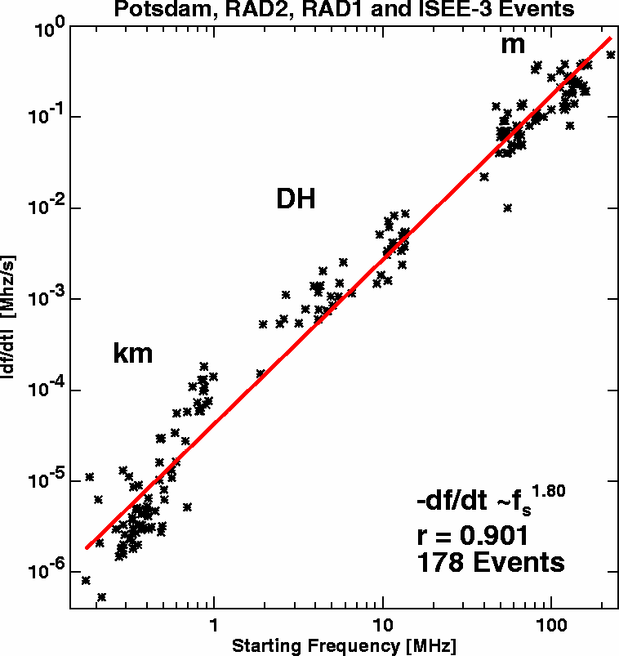
Speed increase in the metric corona
ε = 1.4
|df/dt| ~ f ^{ε}
ε = 2.3
Aguilar-Rodriguez et al., 2005; Vrsnak et al., 2001

Slide 6
Overview
10 m type IIs
6 had SWAVES (DH)
1 m to km (interplanetary)
8 in 2007
2 in 2008
Mostly small S/C separation
(0 – 50 degrees)
No type II since 4/26/08

Slide 7
Metric type II and CME Properties
Date | Time range | f _{e} –f_{s} (MHz) | df/dt MHz/s | DH II | V_{C} km/s | V_{L} km/s | W deg | AR flr Loc | BE AE AB deg
07/01/25 | 06:47 -06:50 | 25-40 | 0.083 | 23:30 | DG | 1367 | 360 | 0940 C6.3 S08E90 | 0.16 0.39 0.54
07/02/19 | 00:18-00:21 | 30-45 | 0.2 | N | 186 | DG | DG | 0943 C1.1 S12E16 | 0.12 0.80 0.91
07/05/19 | 12:51-13:18 | 38-167? | 0.25 | 13:05 | 1624 | 958 | 106 | 0956 B9.5 N07W06 | 2.1 5.9 8.6
07/05/22 | 14:36-14:55 | 25-82? | 0.05 | N | 356 | 544 | 108 | 0956 B3.9 N02W42* | 3.1 6.0 9.1
07/05/23 | 07:22-07:33 | 25-180 | 0.07 | N | 609 | 679 | 90 | 0956 B5.3 N02W55* | 3.2 6.0 9.2
07/06/03 | 09:28-09:42 | 28-84 | 0.15 | Y? | 491 | 467 | 71 | 0960 C5.3 S08E67 | 3.9 7.1 11.0
07/08/06 | 09:16-09:21 | 25-94? | 0.08 | N | 333 | 379 | 66 | 966 C1.5 S05E41 | 9.8 13.5 23.3
07/12/31 | 00:53-01:11 | 30-118? | 0.11 | 01:22 | 771 | 995 | 164 | 0980 C8.3 S08E81 | 22.8 21.2 44.0
08/03/25 | 18:52-19:00 | 25-60 | 0.07 | 19:20 | 773 | 1103 | 90 | 0989M1.7 S13E78 | 23.7 23.5 47.1
08/04/26 | 14:12-14:22 | 25-45? | 0.024 | 14:15 | 335 | 515 | 281 | ?? B3.8 N08E09 | 24.0 25.6 49.5

Slide 8
General Results
Extremely weak flares: 4 B, 5 C & 1 M
Energetic CMEs: < V_{LASCO} > ~774 km/s, W ≥66º
V_{m} ~ 534 km/s V_{DH} 808 km/s V_{mkm} 1367 km/s
V_{COR1} < V_{LASCO} [2 exceptions: 1 impulsive]
Six of the 10 metric type II bursts had CME observation when the burst was in progress

Slide 9
Metric Type II
118 MHz
25 MHz
00:52
01:12
01:22 DH Type II end
df/dt ~0.1 MHz/s

Slide 10
SWAVES Type II
H
F

Slide 11
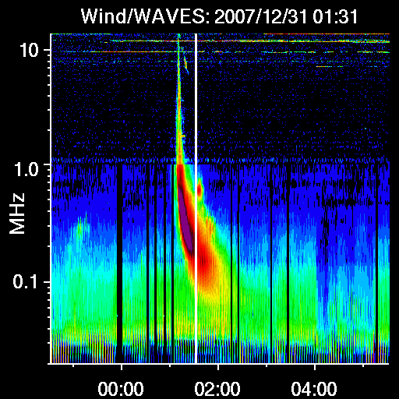
DH Type II
Type III
Shock?
Type II

Slide 13
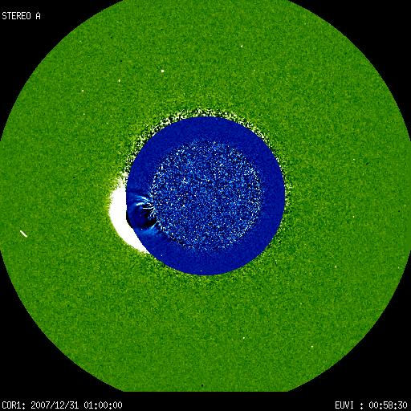
CME at the Time of Type II
2007/12/31 COR1 & EUVI
- 01:12
SA
Shock
DH
CME
COR1 01:00:00
171 00:50:30
SA, E, SB View: E101, S08E81, E58
1.4 Ro

Slide 14
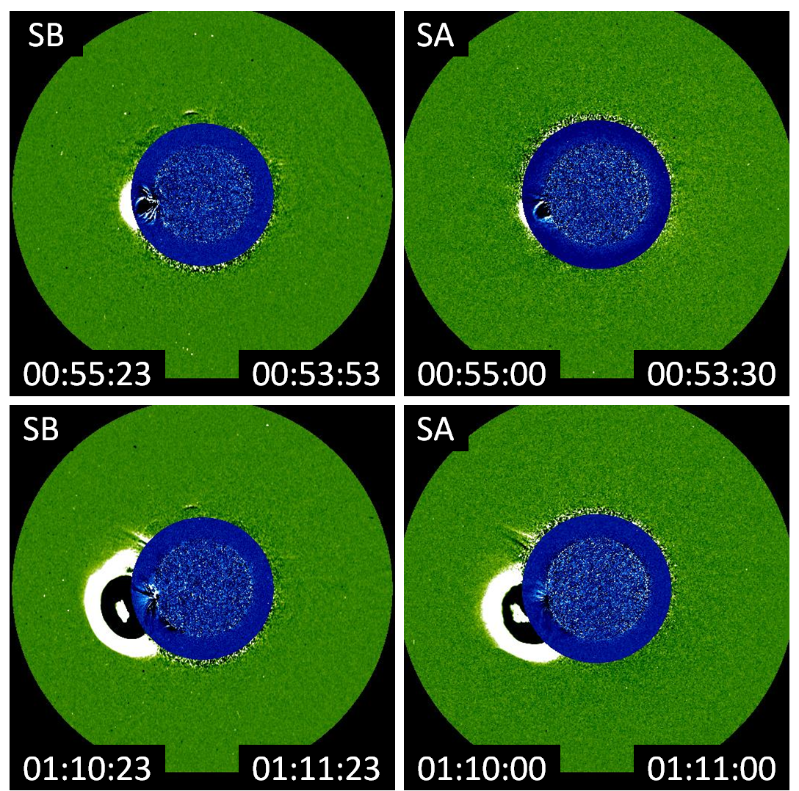
COR1 + EUVI 284 images of the CME
LE 1.77 Ro
LE 1.6 Ro
COR1/EUVI images available at
several instances during type II
The CME was in the height range
1.4 – 3.3 Ro when the type II
started in the metric domain and
ended in the DH domain
Disturbances around the CME became
clear after the type II ended
m-type II Start
LE 2.51Ro
LE 2.4 Ro
m-type II End

Slide 15
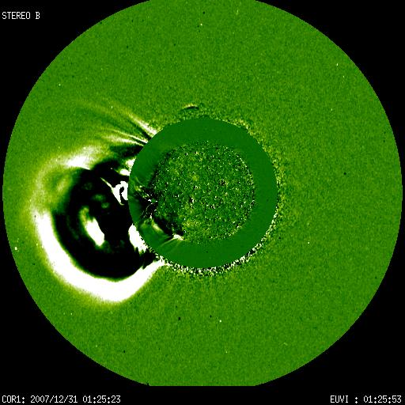
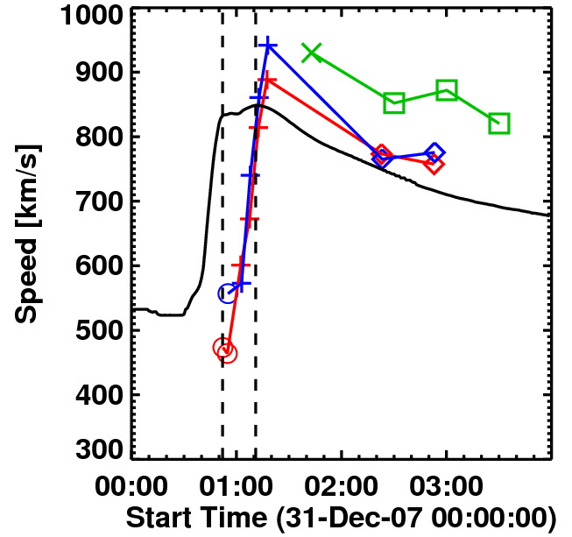
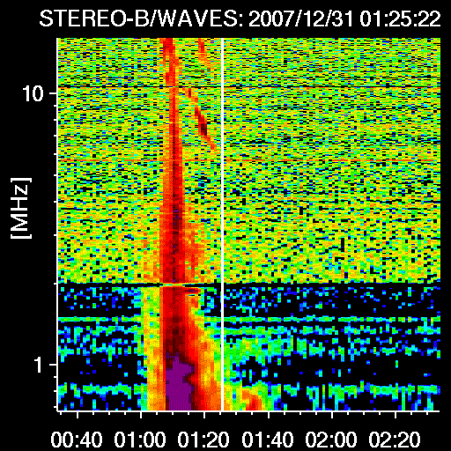
Disturbance Surrounding the CME
2007/12/31 COR1 & EUVI
SB
A
C
DH end
B
COR1 01:25:23
195 01:25:53

Slide 16
CME Speed & Va Profiles
Speed peaks at 1:20 UT
CME
DH end
1:22 UT
Va

Slide 17
Alfven Speed can vary by a factor of 5
N = 3.3×10⁵ r^{–2} + 4.1×10⁶r^{–4} + 8.0×10⁷ r^{–6} cm^{–3}
2 G, 1x

Slide 18
Speed increase in the metric corona
Shock travels with a speed V emitting at successively lower f determined by the local plasma density:
n ~ r^{-α} or f ~ r^{-α/2}
|df/dt| = V(df/dr) ~ Vf^{(α+2)/α} = Vf²
if V=const. & α =2 (Vrsnak et al., 2001)
V may be slowly varying far away from the Sun, but not in the COR1 FOV
=2 may not be true
Deviations imply speed increase near the Sun and decrease in the IP medium
ε = 1.4
|df/dt| ~ f ^{ε}
ε = 2.3

Slide 19
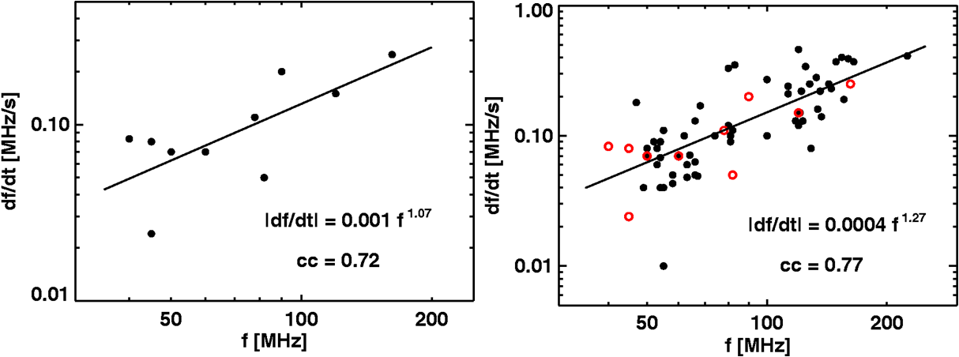
Drift – Rate Spectrum (metric)
If speed varies as V~r^{-β} ~ f^{2β/α} [since f ~ r^{-α/2} ]
|df/dt| ~ f ^{(α +2β+2)/α} = f ^{ε} with ε = (α +2β+2)/α

Slide 20
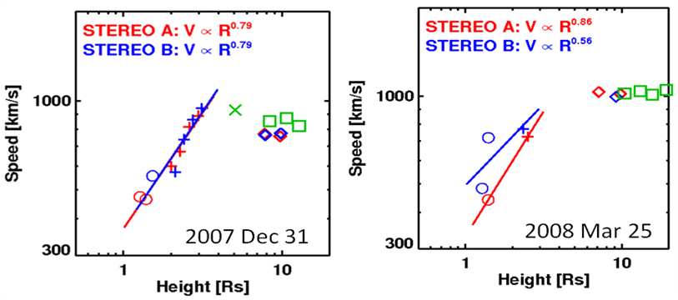
= (α +2β+2)/α
β = - 0.79 → ε = 1.04 for α = 6
β = - 0.86 → ε = 1.05
Consistent with the observed ε = 1.07
β = - 0.79
β = - 0.86 STEREO A Limb View

Slide 21
Low frequency Part
If speed varies as V~r^{-β} ~f^{2β/α} [since f ~ r^{-α/2} ]
|df/dt| ~ f ^{(α +2β+2)/α} = f ^{ε} with ε = (α +2β+2)/α

Slide 22
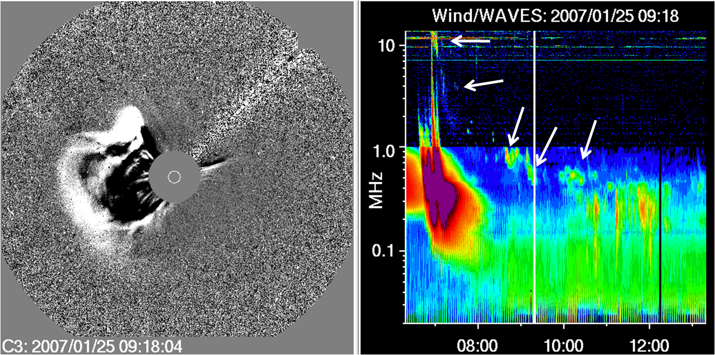
IP Type II
Type II

Slide 23
Type II not Reported!
40 – 24 MHz 0.08 MHz/s

Slide 24
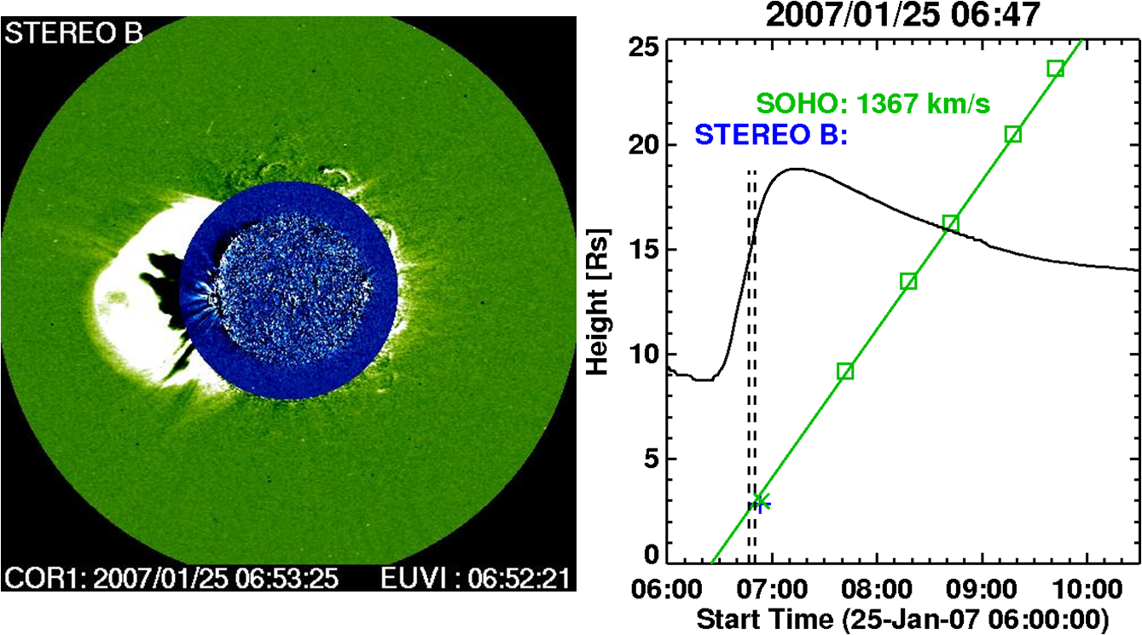
metric to kilometric Type II

Slide 25
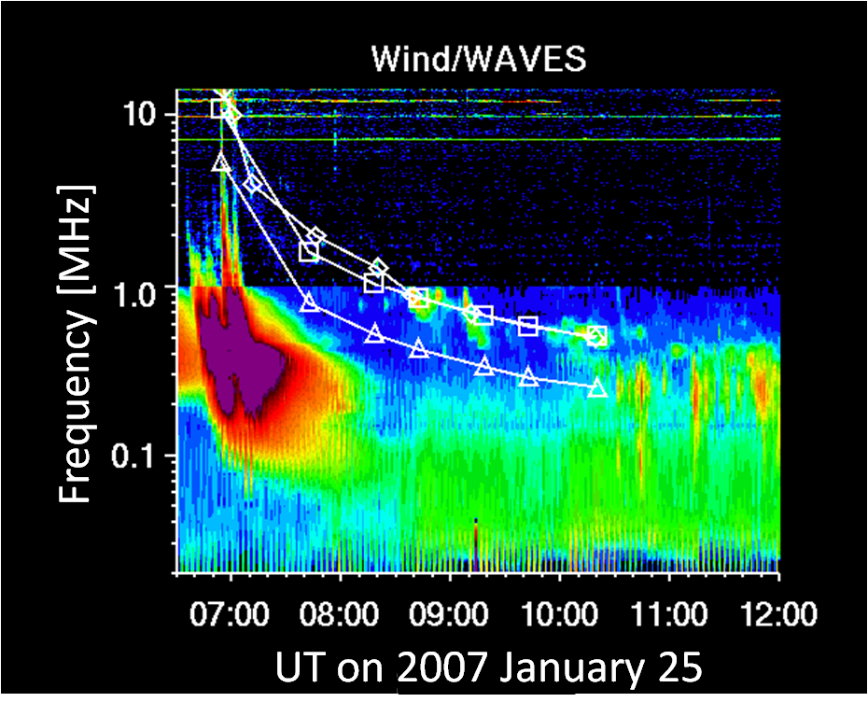
Combining dynamic Spectrum with CME Height –Time
Frequency of emission
~ CME leading edge
H
F

Slide 26
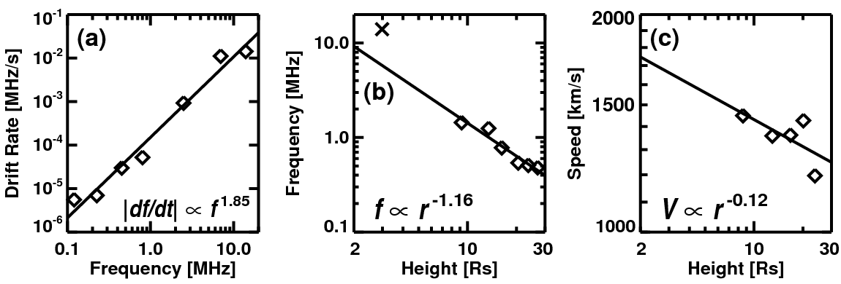
= (α +2β+2)/α
β = 0.12 → ε = 1.97 for α = 2.32
Consistent with the observed ε = 1.85
β = 0, α = 2 → ε = 2 Speed is ~constant within C3 FOV
β = +0.12
Confirms r dependence
of density. α = 2.32
Try this with HI

Slide 27
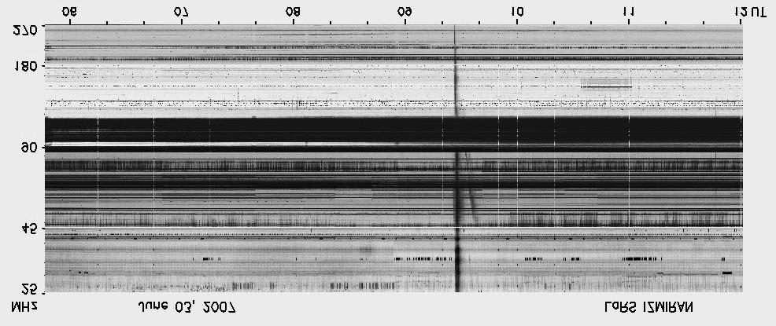
Impulsive Event
IZMIRAN
H
F
2007 June 3

Slide 29
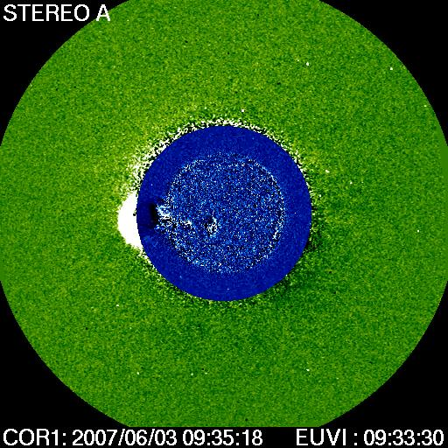
Impulsive Events
CME observed when metric type II in progress
F
DH end
09:54 UT
CME at a height of 1.87 Rs @09:33
Notes:
(left) The 2007 June 3 CME in the COR1 FOV imaged during the metric type II burst. The superposed EUVI difference image shows a bubble shaped dimming region, which roughly underlies the COR1 CME. (right) the composite height-time plots from SA, SB, and SOHO. The COR1 image on the left is the only time the CME was observed during the short-lived type II burst. However, the EUVI shows the CME in several frames (shown by circles). The CME originated close to the east limb, so the projection effects are minimal. The average speeds from the three sets of data agree well with each other. However, the speed seems to vary rapidly within the COR1 FOV (see next Fig.).

Slide 30
Impulsive Events
CME peak speed at 1.5 Ro!
Type II start near flare peak, speed peak
Speed drops from
~925 km/s to 700 km/s
during m type II and
~500 km/s at end of DH
DH
Close connection between CME speed and SXR flare light curve even for an impulsive event
Notes:
Speed as a function of radial distance (left) and time (right) for the 2007 June 3 event. A combination of the EUVI and COR1 data shows that the CME reached a very high speed early on, just before the start of the metric type II burst and then drops to ~400 km/s before the CME crossed the COR1 FOV. The sudden drop in speed is consistent with the impulsive flare as seen from the GOES soft X-ray light curve (right). The speed in the outer corona (393 km/s) was less than the speed in the COR1 FOV.

Slide 31
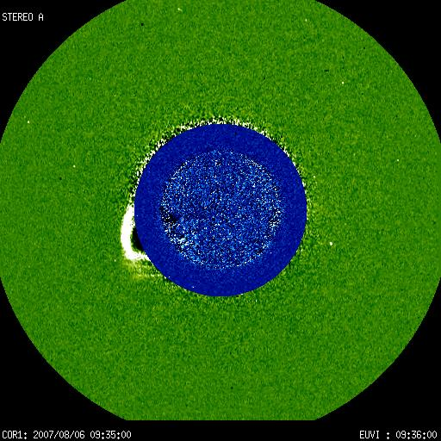

Slide 32
Summary
Metric type II burst starts at a height where the VA is minimum (~1.4 Ro)
The CME height at type II onset ~1.5 Ro compared to 2.2 Ro from LASCO
Min to Max density variation (factor of 4)?
LASCO does not capture initial speed variation?
Type II ends when the shock becomes subcritical or dissipates
Deviations from the universal drift rate spectrum are a direct consequence of the CME speed increase in the inner corona and decrease in the IP medium
GOES light curve and CME speed follow each other even for impulsive flares

Slide 33
Double Peak in the 20071231 Event

Slide 34
http://cdaw.gsfc.nasa.gov/pub/yashiro/stereo/movie/20071231_cor1rdswaves.html

